Slide 1

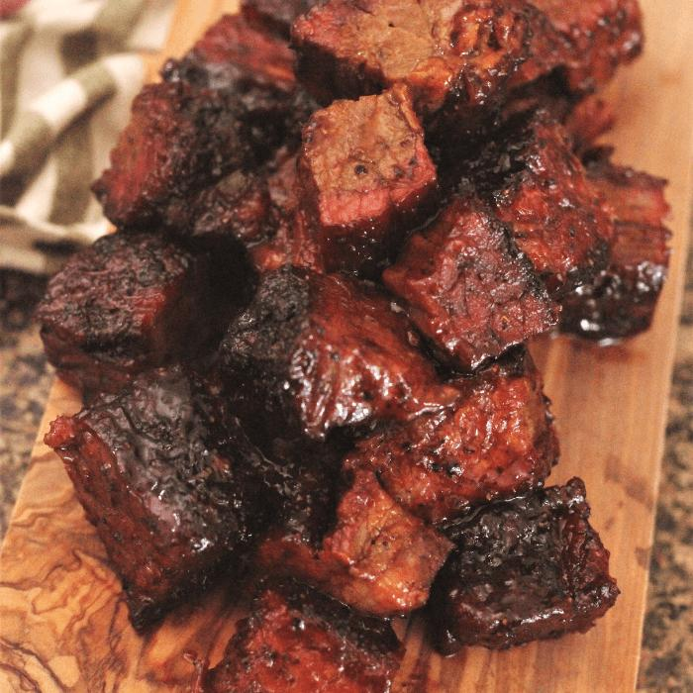
Burnt Ends- NIL Program
How Surly uses the NIL for make benefit glorious nation of Texas Football

Slide 2

Our Goal
Sponsor the Texas TE Room via crowd sourced donations
Even split of money for the TE Room continuous month over month over month
Recurring yearly endowments to attract and KEEP top TE talent in the program
Active support and activity from the TE Room on Surly
Have a good fucking time (Both Surly and the TE Room)

Slide 3
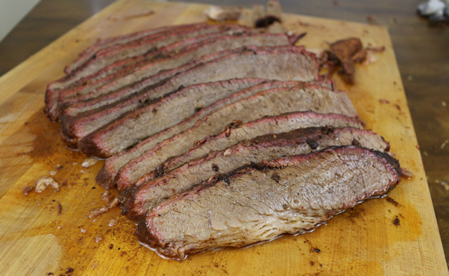
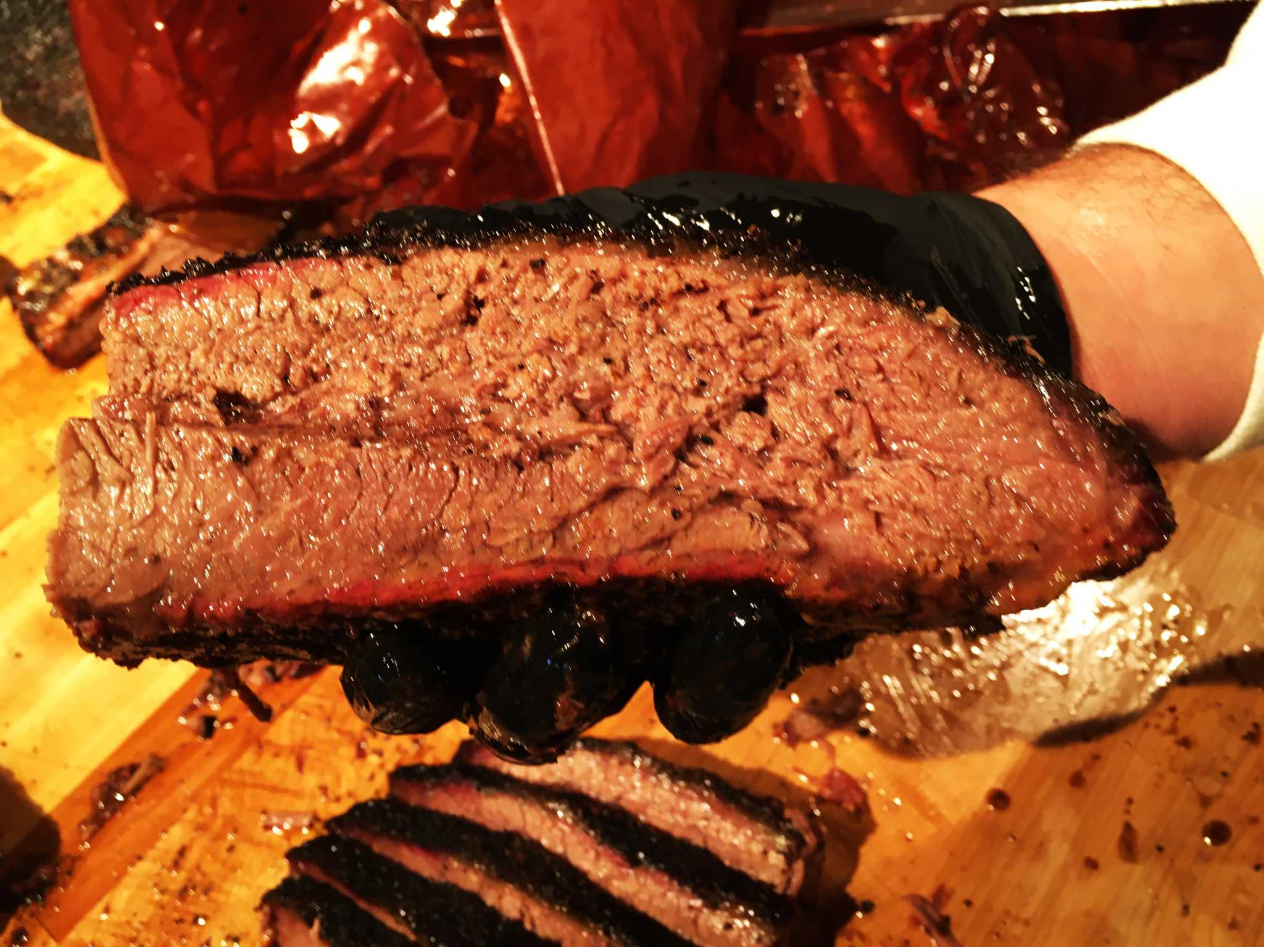
How we make this happen
Monthly Subscription program- Pure Profit goes to the TE room
$10 Burnt Ends- New Username flare and access to a separate board where the TEs will post
$25 Flat- $10 tier + Car Sticker and RTIC Cup
$50 Point-$10 & $25 tier+ Access to yearly dinner with TE Group

Slide 4
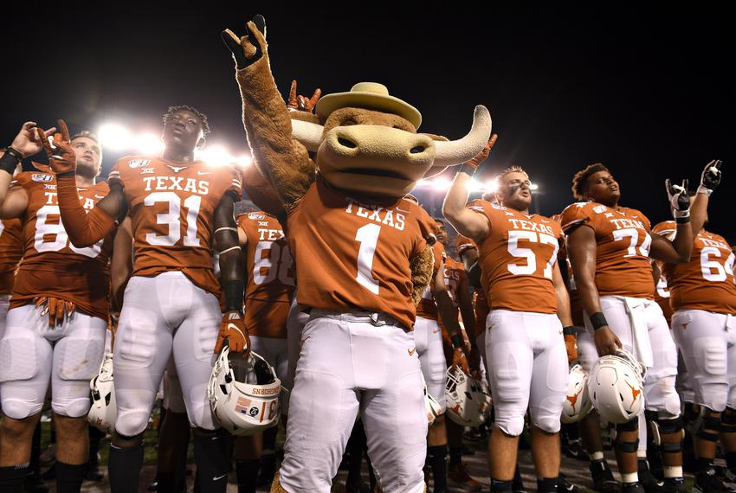
What does Surly get?
Yearly group dinner with the TE group for certain donation levels
Podcast appearances during the offseason and Sunday wrap ups during the season
Active TE room board participation- Scheduled AMAs, separate board/safe space for TEs to post
Burnt Ends Camp for Burnt Out Athletes
The knowledge that YOU are actually making a difference with the program

Slide 5
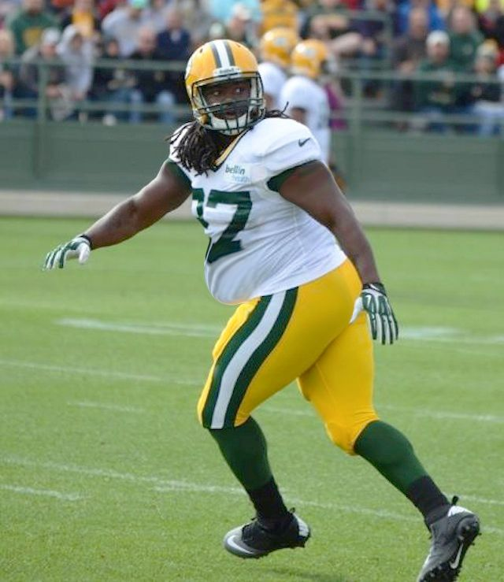
Burnt Ends Camp for Washed Up Athletes
$500 a head, profit goes to the TE group
Rent out a ranch (or some rich fuck donates it)
Scheduled set of events- TE drills, 7 on 7 tourney, beer pong tourney, softball tourney, Cornhole etc
Catered dinner to follow- Pinkertons?

Slide 6
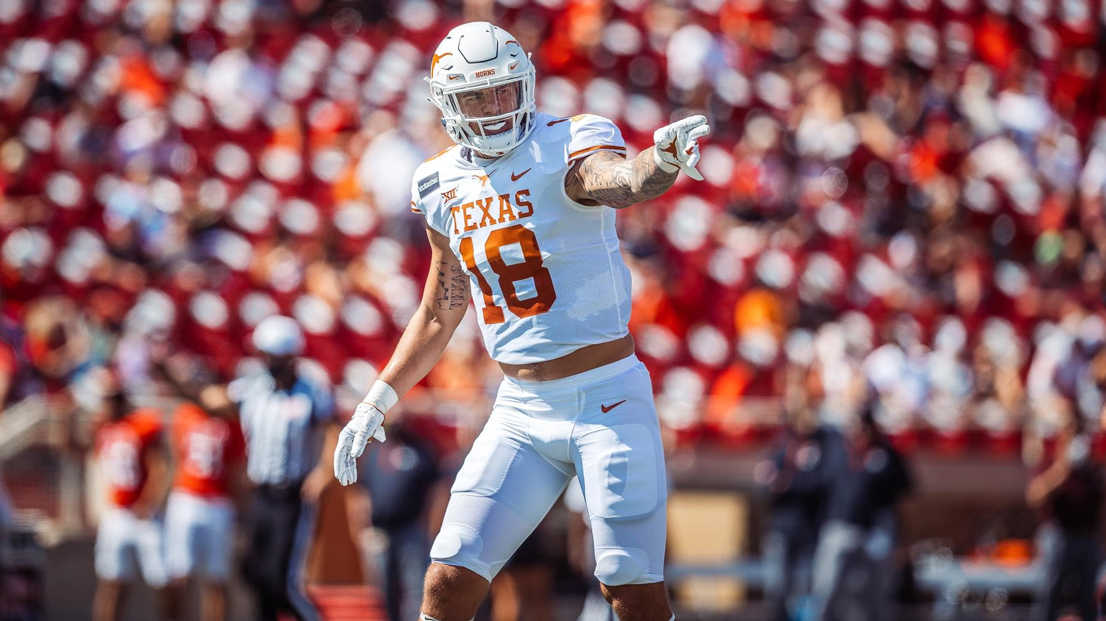
Current TE Room
Cade Brewer- Senior
Jared Wiley- Junior
Nathan Hatter- Sophomore
Brayden Liebrock- Sophomore
Juan Davis- Freshman
Gunnar Helm- Freshman
Jatavion Sanders- Freshman

Slide 7
Fundraising Goal
Monthly donors-
50 people at $10 per month- $5,000 yearly
150 people at $25 per month- $45,000 yearly
50 people at $50 per month- $30,000 yearly
Expenses $10,000~ yearly
$70,000~ yearly to distribute 7 ways- $10,000~ per TE per year
Burnt Ends Camp-
50 people at $500- $25,000 minus overheard ($10,000~)
Additional $2500~ per TE
Total Yearly goal per TE- $12,000-$15,000 per TE per year

Slide 8
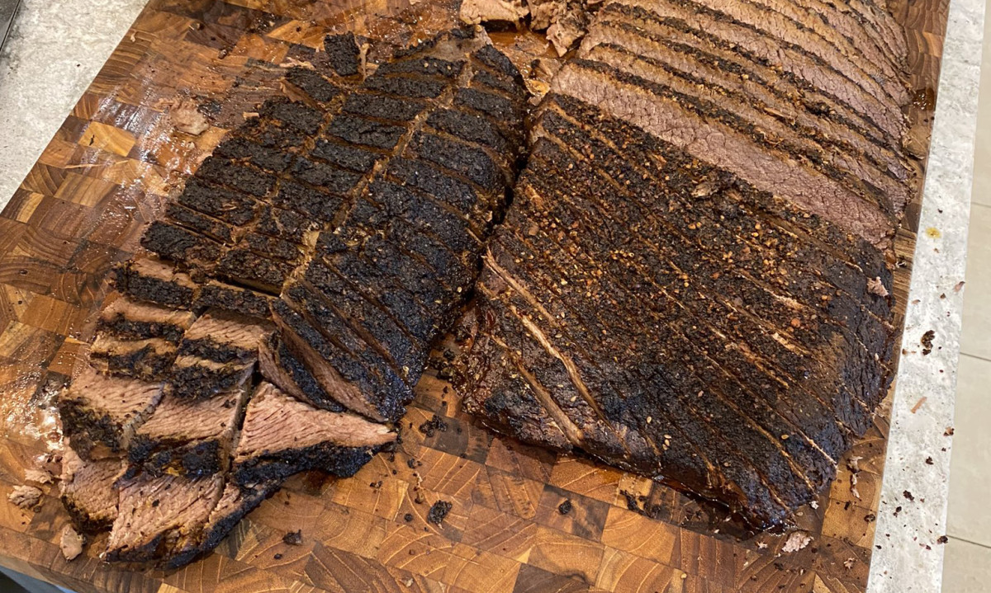
Don’t be a Riley Brisket! Be a Burnt End!

